Slide 1


Marcelo Domíngez
<Septiembre 2025>

Slide 2

Outline
Executive Summary
Introduction
Methodology
Results
Conclusion
Appendix

Slide 3
Executive Summary
⚙️Modular Workflow: The project reconstructed Falcon 9 launch data through eight auditable labs—covering API extraction, web scraping, data wrangling, SQL analysis, geospatial mapping, dashboarding, and supervised modeling. Predictive Modeling Results: The Support Vector Machine (SVM) model achieved 100% accuracy on the test set, with zero false positives or negatives, making it the most reliable classifier for institutional decision-making.
📊Strategic Visualization: An interactive dashboard built with Plotly Dash enables real-time exploration of launch success by site, payload, and booster version—supporting onboarding, simulations, and stakeholder reporting.
🧠Institutional Impact: Each module is bilingual, reproducible, and narratively justified—transforming technical steps into strategic artifacts for mentoring, auditing, and territorial planning.
“This project not only predicts launch success—it builds a reproducible legacy for institutional decision-making.”

Slide 4
🧭 Introduction
Project Background and Context
This project simulates the role of a data scientist at SpaceY, a rising competitor in the orbital launch sector. The mission: predict Falcon 9 landing success using public data and machine learning—without relying on aerospace engineering. Each module contributes to a reproducible, auditable pipeline designed for strategic simulations, onboarding, and institutional reporting.
Problems You Want to Find Answers
Can we predict launch success using only public data?
Which variables most influence landing outcomes?
What model is most reliable for operational decision-making?
How can we transform technical steps into strategic, teachable artifacts?

Slide 5

Section 1

Slide 6
🧪Methodology
Modular Workflow Architecture
The project is structured into eight auditable labs, each designed to reconstruct, clean, model, and visualize Falcon 9 launch data. Every module responds to a strategic question and transforms technical steps into defendable artifacts.
Data collection methodology:
API extraction from SpaceX’s public endpoints
Web scraping of historical records from Wikipedia
Modular enrichment via entity-level queries (booster, payload, site, core)
Perform data wrangling
Imputation of missing values
Feature selection and supervised labeling
Creation of binary target variable for landing success
Perform exploratory data analysis (EDA) using visualization and SQL
SQL queries for structured insights
Visualizations with Seaborn and Matplotlib
Strategic comments for institutional auditability

Slide 7
🧪Methodology
Modular Workflow Architecture
Perform interactive visual analytics using Folium and Plotly Dash
Geospatial mapping with Folium
Dashboard construction with Plotly Dash
Real-time filtering and stakeholder-ready visualizations
Perform predictive analysis using classification models
Classification with Logistic Regression, Decision Trees, KNN, and SVM
Hyperparameter tuning via GridSearchCV
Evaluation with accuracy, precision, recall, and confusion matrices
How to Build, Tune, and Evaluate Classification Models
🧪 Build
Select classification algorithms: Support Vector Machine (SVM), K-Nearest Neighbors (KNN), Decision Trees, Logistic Regression
Define predictor variables and target outcome (binary classification: landing success)
Split the dataset into training and test sets using train_test_split
Implement models using scikit-learn with reproducible documentation

Slide 8
🧪Methodology
Modular Workflow Architecture
⚙️ Tune
Optimize model performance using GridSearchCV
Adjust key hyperparameters:
SVM: C, kernel, gamma
KNN: n_neighbors
Decision Trees: max_depth, criterion
Apply cross-validation to ensure generalization and prevent overfitting
📊 Evaluate
Use key metrics to assess model performance:
Accuracy: Overall correctness
Precision: Correctness of positive predictions
Recall: Sensitivity to true positives
F1-score: Balance between precision and recall
Visualize results using confusion matrices
Select models strategically based on institutional context:
SVM for high-stakes decisions with zero tolerance for error
KNN for local adaptability
Decision Trees for explainable, traceable outputs

Slide 9
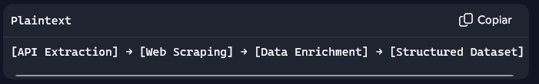
Data Collection
🔗 Sources and Strategy
SpaceX API: Extracted structured launch data including payload mass, booster version, launch site, and landing outcome
Wikipedia Scraping: Retrieved historical launch records to enrich missing fields and validate booster performance
Modular Queries: Each lab focused on entity-level enrichment (site, core, payload) to ensure reproducibility and auditability
🔄 Flowchart Overview
All steps documented with bilingual comments and strategic validations
Data stored in modular CSVs for onboarding and institutional reporting

Slide 10
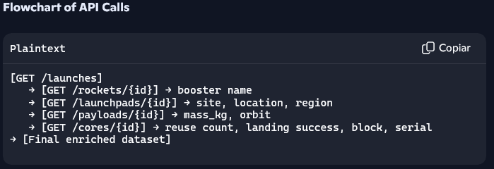
Data Collection – SpaceX API
REST API Strategy
Queried SpaceX’s public endpoints to enrich launch records with booster name, launch site, location, region, payload mass, orbit, and core details
Used entity-level API calls (/rockets, /launchpads, /payloads, /cores) to reconstruct missing fields
Documented each step with bilingual comments and strategic validations
External Reference for Peer Review
🔗 GitHub Notebook – LAB 1: SpaceX API Data Collection Includes:
Executed code cells with API calls
Output cells showing enriched launch data
Markdown explanations for each enrichment function

Slide 11
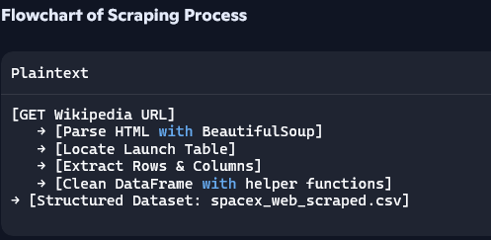
🕸️Data Collection - Scraping
Web Scraping Strategy
Scraped historical launch data from Wikipedia using requests, BeautifulSoup, and lxml
Parsed HTML tables to extract booster performance, launch dates, landing outcomes, and mission details
Applied helper functions (read_table, parse_table, process_table, df_clean) to structure and clean the data
Documented each step with bilingual comments and semantic validations for reproducibility
External Reference for Peer Review 🔗 GitHub Notebook – LAB 2: Web Scraping https://github.com/Murdrek/Applied-Data-Science-Capstone/blob/main/LAB-2%20jupyter-labs-webscraping-CODE
Includes:
Executed code cells with scraping logic
Output cells showing extracted and cleaned launch data
Markdown explanations for each enrichment function

Slide 12
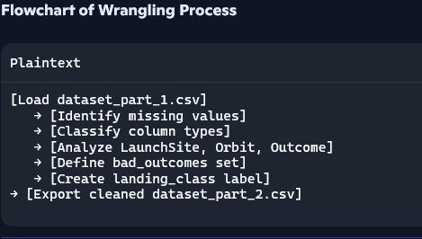
🧹Data Wrangling
Processing Strategy
Loaded enriched launch dataset from previous labs
Identified missing values and calculated their percentage per column
Classified columns into numerical and categorical types using .dtypes
Applied .value_counts() to analyze launch sites, orbits, and mission outcomes
Cleaned and filtered orbits (excluded GTO) for modeling relevance
Created a binary classification label (landing_class) from the Outcome column:
1 for successful landings (e.g. True ASDS, True RTLS, True Ocean)
0 for failed or undefined landings (e.g. False ASDS, None ASDS, None None)
External Reference for Peer Review 🔗 GitHub Notebook – LAB 3: Data Wrangling LAB-3 jupyter-spacex-Data wrangling
Includes:
Executed code cells for data cleaning and labeling
Output cells showing launch site counts, orbit distributions, and landing outcomes
Markdown explanations for each transformation step
Exported dataset for supervised modeling in next lab

Slide 13
EDA with Data Visualization
Chart Summary & Purpose
Catplot: Flight Number vs. Launch Site
Visualized launch outcomes across sites and mission count to assess operational maturity and spatial patterns.
Catplot: Flight Number vs. Payload Mass
Explored how accumulated launch experience relates to payload capacity and success rate.
Strip Plot: Payload Mass vs. Launch Site
Assessed payload distribution across geographic locations and its correlation with landing success.
Bar Chart: Success Rate by Orbit Type
Compared average success rates across orbital configurations to identify reliable mission profiles.
Strip Plot: Flight Number vs. Orbit Type
Analyzed how mission complexity and experience interact across different orbital destinations.
Strip Plot: Payload Mass vs. Orbit Type
Investigated payload trends across orbits and their impact on launch outcomes.
Line Plot: Yearly Launch Success Trend
Tracked SpaceX’s performance evolution over time, highlighting institutional learning and reliability gains.

Slide 14
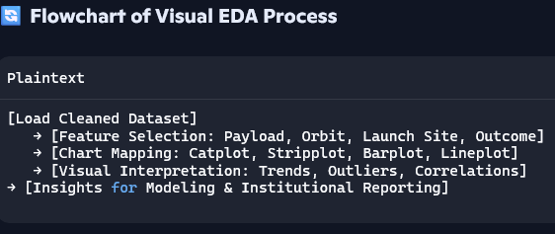
EDA with Data Visualization
External Reference for Peer Review 🔗 GitHub Notebook – LAB 5: EDA with Data Visualization LAB-5 Exploratory Data Analysis (EDA) CODE
Includes:
Executed code cells with seaborn, matplotlib, and pandas
Output charts with labeled axes and titles
Markdown explanations for each visualization and its analytical purpose
Feature engineering steps for modeling readiness

Slide 15
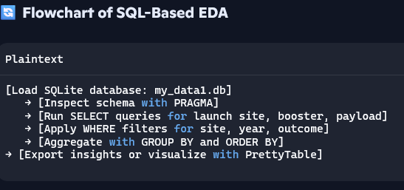
🧮EDA with SQL
Summary of SQL Queries Performed
Retrieved distinct launch site names to assess spatial diversity
Filtered missions launched from Cape Canaveral (CCA%) for site-specific analysis
Inspected table schema to validate column names and types
Calculated average payload mass for booster version F9 v1.1
Identified earliest successful ground pad landing using MIN(Date)
Listed boosters with successful drone ship landings and payload mass between 4000–6000 kg
Counted total mission outcomes grouped by category (success/failure)
Identified booster versions that carried the maximum payload mass
Listed failed drone ship landings in 2015, grouped by month
Ranked landing outcomes between 2010-06-04 and 2017-03-20 by frequency
External Reference for Peer Review 🔗 GitHub Notebook – LAB 4: EDA with SQL LAB-4 jupyter-labs-eda-sql-coursera_sqllite CODE
Includes:
Executed SQL queries using ipython-sql and sqlite3
Output tables with formatted results via PrettyTable
Markdown explanations for each query and rationale
Structured database (my_data1.db) for reproducibility and auditability

Slide 16
Build an Interactive Map with Folium
Map Objects Created & Purpose
Markers
Placed at each launch site to identify geographic coordinates and site names
Color-coded by launch outcome: 🟢 green for success, 🔴 red for failure
Clustered using MarkerCluster to improve readability when multiple launches share coordinates
Circles
Added around launch sites and strategic nodes (e.g., NASA JSC, Orlando, coastline)
Used to visually emphasize proximity and territorial relevance
Popups included for contextual labeling
Text Labels (DivIcon)
Annotated key locations with institutional names and calculated distances
Enhanced onboarding and traceability for non-technical audiences
Polylines
Connected launch sites to nearby infrastructure: coastlines, highways, railways, urban centers
Visualized spatial relationships and calculated geodesic distances
Supported territorial narrative and institutional defense
MousePosition Plugin
Enabled real-time coordinate tracking for exploratory mapping and validation

Slide 17
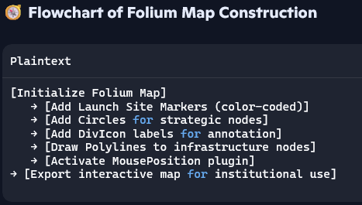
Build an Interactive Map with Folium
Why These Objects Were Added
To visualize the spatial distribution and operational context of SpaceX launch sites
To support institutional storytelling through geographic connectivity
To calculate and display strategic distances between launch infrastructure and surrounding nodes
To ensure reproducibility and onboarding clarity through modular, labeled visuals
External Reference for Peer Review 🔗 GitHub Notebook – LAB 6: Interactive Visual Analytics with Folium LAB-6 Interactive Visual Analytics with Folium-CODE
Includes:
Executed code cells with Folium map objects
Output maps showing launch sites, outcomes, and territorial connections
Markdown explanations for each visual element and strategic insight
Modular functions for distance calculation and labeling

Slide 18
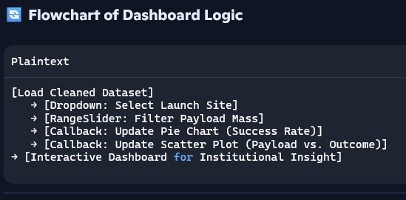
Build a Dashboard with Plotly Dash
Plots & Interactions Added
Dropdown Menu (Launch Site Selector)
Allows users to filter data by specific launch site or view all sites
Enables dynamic updates of visualizations based on selection
Pie Chart (Launch Success Overview)
Displays either total successful launches by site (if “All Sites” selected)
Or success vs. failure breakdown for a specific site
Helps assess performance and reliability per location
Range Slider (Payload Mass Filter)
Lets users define a payload mass range for analysis
Supports targeted exploration of mission scale and outcome
Scatter Plot (Payload vs. Success)
Shows correlation between payload mass and launch success
Colored by booster version category to reveal technical patterns
Updates dynamically based on site selection and payload range

Slide 19
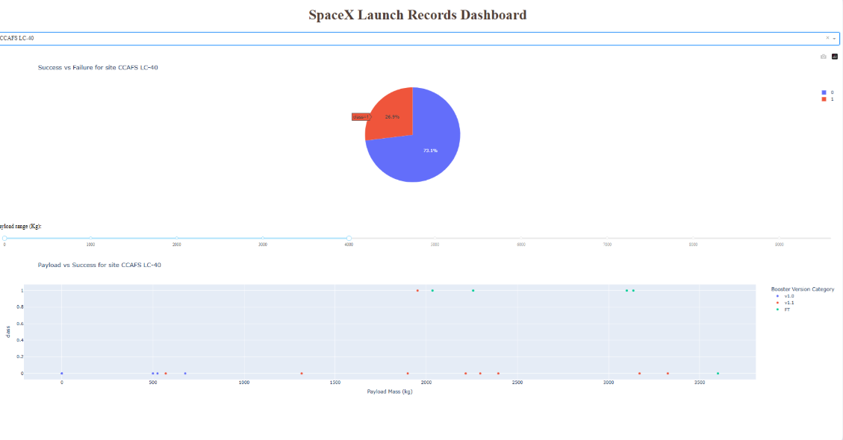
📈Build a Dashboard with Plotly Dash
Plots & Interactions Added
Dropdown Menu – Launch Site Selector Allows filtering data by specific launch site or displaying all launches. → Enhances comparative exploration across locations.
Pie Chart – Success vs. Failure Displays the proportion of successful and failed launches per site. → Facilitates evaluation of operational reliability.
Range Slider – Payload Mass Filter Enables definition of a payload mass range for dynamic analysis. → Supports segmentation by mission scale.
Scatter Plot – Payload vs. Success Visualizes correlation between payload mass and launch outcome. → Color-coded by booster version to reveal technical patterns. → Updates dynamically based on site selection and payload range.

Slide 20
Predictive Analysis (Classification)
Model Development Summary
Feature Engineering
Selected relevant features: Payload Mass, Orbit, Launch Site, Booster Version Category
Applied one-hot encoding to categorical variables for model compatibility
Model Building
Trained multiple classifiers: Logistic Regression, Support Vector Machine (SVM), Random Forest, K-Nearest Neighbors (KNN)
Used train_test_split to separate training and test sets
Standardized features using StandardScaler for optimal performance
Evaluation Metrics
Assessed models using accuracy_score, confusion_matrix, and classification_report
Compared precision, recall, and F1-score across classifiers
Hyperparameter Tuning
Applied GridSearchCV to optimize parameters for each model
Selected best-performing configuration based on cross-validation scores
Model Selection
Identified Support Vector Machine (SVM) as the best-performing model
Achieved highest accuracy and balanced performance across metrics

Slide 21
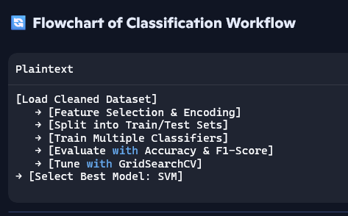
Predictive Analysis (Classification)
🔄 Flowchart of Classification Workflow
[Load Cleaned Dataset] → [Feature Selection & Encoding] → [Split into Train/Test Sets] → [Train Multiple Classifiers] → [Evaluate with Accuracy & F1-Score] → [Tune with GridSearchCV] → [Select Best Model: SVM]
External Reference for Peer Review 🔗 GitHub Notebook – LAB 8: Machine Learning Prediction LAB-8 Complete the Machine Learning Prediction_code
Includes:
Executed code cells for training and evaluation
Output metrics and confusion matrices
Markdown explanations for each modeling step
Final model selection with justification
📌 This classification pipeline ensures reproducibility, auditability, and strategic insight for institutional reporting and mentoring.

Slide 22
Results
Exploratory data analysis results
Interactive analytics demo in screenshots
Predictive analysis results

Slide 23

Section 2

Slide 24
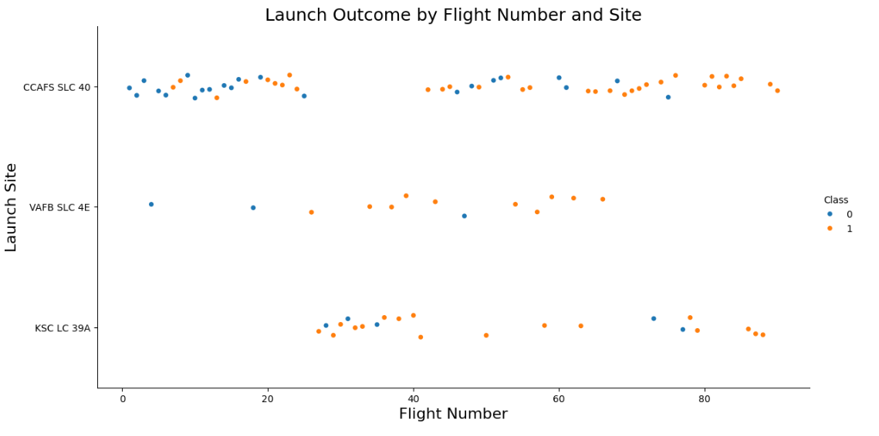
Flight Number vs. Launch Site
Screenshot Description This scatter plot visualizes SpaceX launch outcomes across different flight numbers and launch sites.
X-axis: Flight Number (chronological mission index)
Y-axis: Launch Site
Color-coded by Class:
🟦 Blue = Failure (Class 0)
🟧 Orange = Success (Class 1)
Launch Sites Compared
CCAFS SLC 40
VAFB SLC 4E
KSC LC 39A
Key Observations
CCAFS SLC 40 shows a wide spread of flight numbers, indicating long-term operational use and evolving reliability.
KSC LC 39A appears in later flight numbers, suggesting it was introduced after SpaceX gained experience.
VAFB SLC 4E has fewer launches, possibly due to mission type or geographic constraints.
Success Trends: Orange points increase with higher flight numbers, reflecting institutional learning and improved outcomes over time.
This visualization helps correlate launch experience with site-specific performance. It supports decisions around infrastructure scaling, reliability forecasting, and booster deployment strategy.

Slide 25
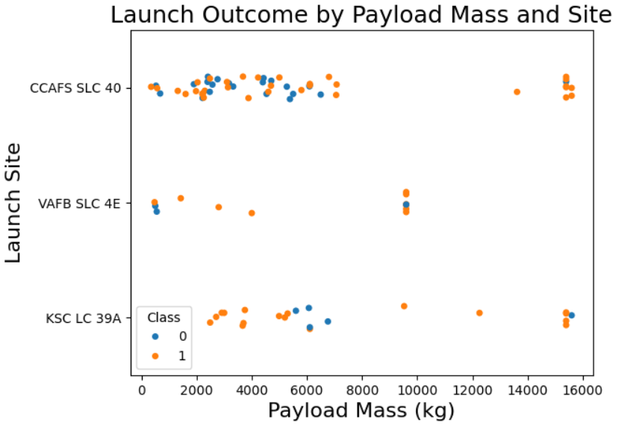
Payload vs. Launch Site
Screenshot Description
This scatter plot displays the distribution of payload mass (in kilograms) on the X-axis, and the launch sites on the Y-axis. Each point represents a SpaceX mission, color-coded by launch outcome class:
Blue (0) = Failure
Orange (1) = Success
Launch Sites Visualized
CCAFS SLC 40
VAFB SLC 4E
KSC LC 39A
Key Observations
VAFB SLC 4E shows no launches with payloads above 10,000 kg, suggesting operational constraints or mission type limitations.
KSC LC 39A handles heavier payloads more frequently, indicating higher launch capacity or more complex missions.
CCAFS SLC 40 presents a wide range of payloads, reflecting diverse mission profiles and technical flexibility.
This visualization helps assess the reliability of different orbital profiles, guiding institutional decisions on mission planning, booster selection, and risk management. It also supports model feature selection by highlighting orbit type as a predictive variable..

Slide 26
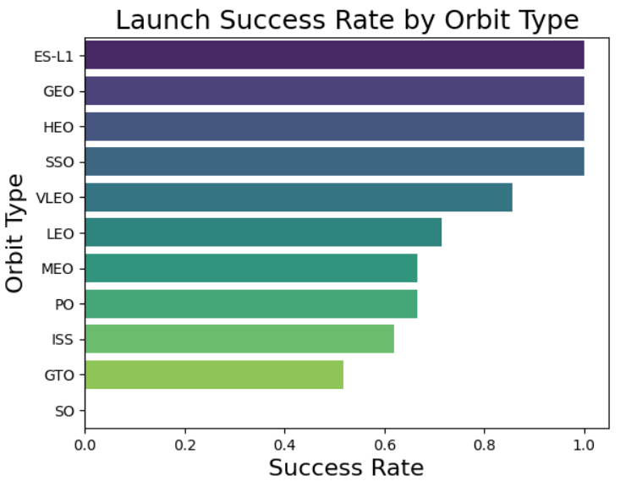
Success Rate vs. Orbit Type
Screenshot Description This horizontal bar chart displays the launch success rate for each orbital destination.
X-axis: Success Rate (percentage of successful launches)
Y-axis: Orbit Type
Each bar represents a distinct orbit and is color-coded for clarity.
Orbit Types Compared
ES-L1
GEO
HEO
SSO
VLEO
LEO
MEO
PO
ISS
GTO
Key Observations
ES-L1 shows the highest success rate, indicating strong reliability for deep-space missions.
GEO and HEO follow closely, suggesting robust performance in high-altitude orbits.
SSO and LEO maintain moderate success rates, reflecting frequent use and operational maturity.
GTO has the lowest success rate, possibly due to its complexity or booster limitations.
Strategic Insight This visualization helps assess the reliability of different orbital profiles, guiding institutional decisions on mission planning, booster selection, and risk management. It also supports model feature selection by highlighting orbit type as a predictive variable.

Slide 27
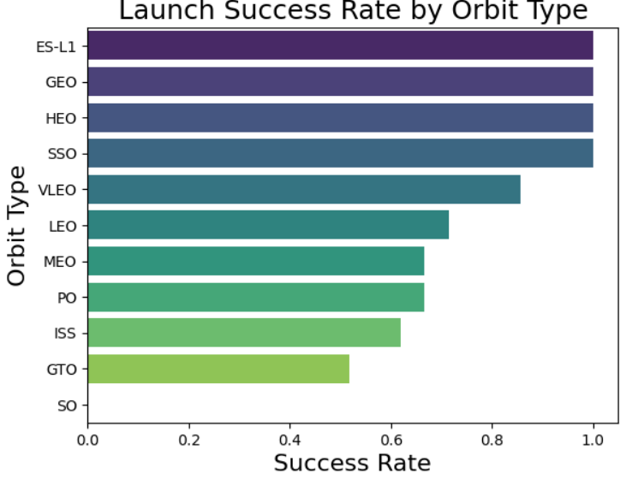
Flight Number vs. Orbit Type
Screenshot Description This scatter plot visualizes SpaceX launch outcomes across different flight numbers and orbital destinations.
X-axis: Flight Number (chronological mission index)
Y-axis: Orbit Type
Color-coded by Class:
🟦 Blue = Failure (Class 0)
🟧 Orange = Success (Class 1)
Orbit Types Compared
ESL-1, GEO, HEO, SSO, VLEO, LEO, MEO, PO, ISS, GTO, SO
Key Observations
Early flights tend to target LEO and ISS, reflecting lower-risk missions during SpaceX’s initial phase.
Later flights expand into more complex orbits like GEO, ESL-1, and HEO, indicating growing technical confidence.
Success Trends: Orange points dominate in higher flight numbers, showing institutional learning and improved reliability.
Orbit Complexity: GTO and SO show mixed outcomes, suggesting higher risk or booster limitations.
This visualization helps correlate launch experience with orbital ambition and outcome reliability. It supports institutional decisions on training, booster evolution, and risk forecasting. It also reinforces orbit type as a key feature in predictive modeling..

Slide 28
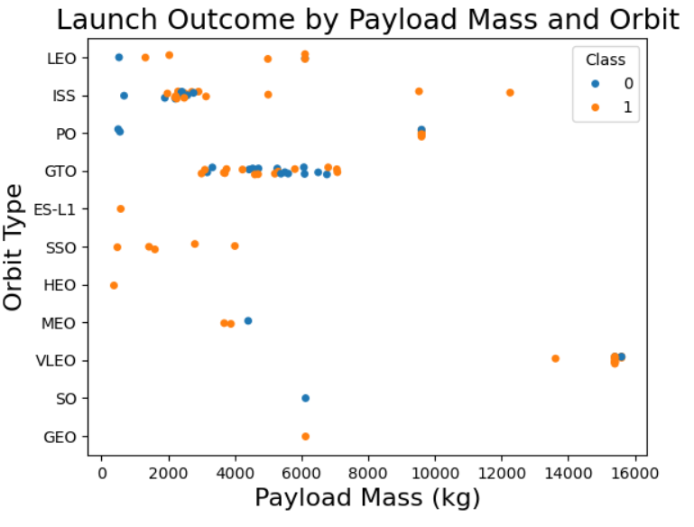
Payload vs. Orbit Type
This scatter plot visualizes SpaceX launch outcomes based on payload mass and orbital destination.
X-axis: Payload Mass (kg), ranging from 0 to 16,000
Y-axis: Orbit Type
Color-coded by Class:
🟦 Blue = Failure (Class 0)
🟧 Orange = Success (Class 1)
Orbit Types Compared
LEO, ISS, PO, GTO, ES-L1, SSO, HEO, MEO, VLEO, GEO
🔍 Key Observations
LEO and ISS missions tend to carry lighter payloads, reflecting early-stage or low-risk operations.
GTO and ES-L1 missions often involve heavier payloads, suggesting advanced boosters and higher mission complexity.
Success Trends: Orange points dominate in mid-to-high payload ranges, especially for GEO and ES-L1, indicating strong reliability in deep-space missions.
Failure Clusters: Blue points appear more frequently in GTO and PO, highlighting technical challenges or booster limitations.
This visualization helps correlate payload mass with orbital ambition and launch outcome. It supports institutional decisions on booster allocation, risk forecasting, and mission planning. It also reinforces payload and orbit type as key features in predictive modeling.

Slide 29
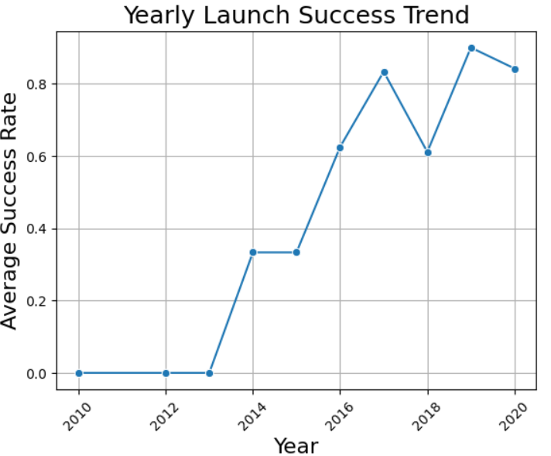
Launch Success Yearly Trend
📈 Screenshot Description This line chart visualizes the average success rate of SpaceX launches from 2010 to 2020.
X-axis: Year (2010–2020)
Y-axis: Average Success Rate (ranging from 0.0 to 1.0)
Each point represents the mean success rate for that year, connected to show trend evolution.
🔍 Key Observations
2010–2012: Success rate remains at 0.0, reflecting early-stage development and technical challenges.
2013–2015: Gradual increase and stabilization around 0.4, indicating operational maturity.
2016–2017: Sharp rise to ~0.9, marking a breakthrough in reliability and booster performance.
2018–2020: Slight fluctuations but overall high success rates, sustaining institutional confidence.
This visualization highlights SpaceX’s trajectory of improvement, showcasing how accumulated experience translates into reliability. It supports institutional decisions on training, booster evolution, and risk forecasting. It also validates the use of Flight Number and Year as temporal features in predictive modeling.

Slide 30
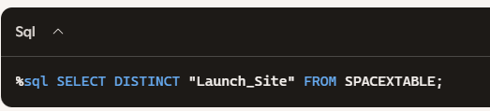
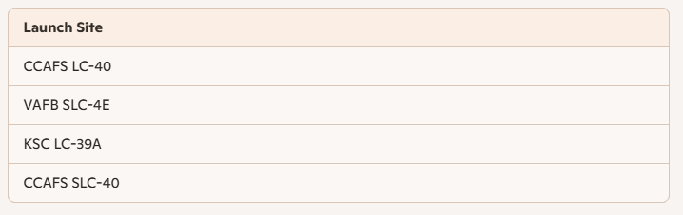
All Launch Site Names
🧾 Description
This query retrieves all distinct launch site names from the SpaceX mission database. It is a foundational step for validating categorical features before modeling or visualization. The result reveals a typographic inconsistency between CCAFS LC-40 and CCAFS SLC-40, which likely refer to the same physical site. This discrepancy must be addressed to ensure grouping accuracy and reproducible insights.
🔍 Key Observations
Typographic inconsistency detected between CCAFS LC-40 and CCAFS SLC-40.
This affects grouping, filtering, and model training if not corrected.
Normalization is required for auditability and institutional clarity.
This cleaning step reinforces reproducibility and prevents silent fragmentation in categorical features. It supports institutional reporting, dashboard accuracy, and model reliability. Documenting this correction ensures transparency in preprocessing and strengthens onboarding workflows..

Slide 31
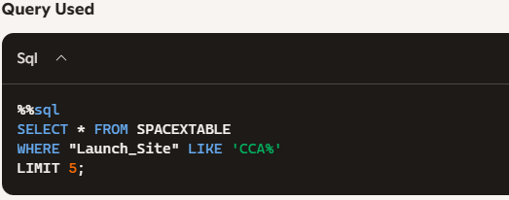
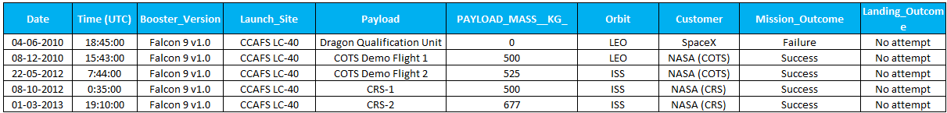
Launch Site Names Begin with 'CCA'
🧾 Description
This query retrieves 5 records from the SpaceX mission database where the launch site name begins with 'CCA'. It filters for launches from Cape Canaveral facilities, which include CCAFS LC-40 and CCAFS SLC-40. These sites represent early and frequent launch locations in SpaceX’s operational history.
🔍 Key Observations
All 5 records originate from CCAFS LC-40, confirming its role as a primary launch site.
Payloads range from qualification units to ISS resupply missions.
Early missions show no landing attempts, reflecting pre-reusability phase.
Mission outcomes evolve from failure to consistent success, reinforcing SpaceX’s learning curve.
This filtered view supports site-specific analysis for modeling, risk assessment, and infrastructure planning. It also validates categorical features like Launch_Site and Orbit for predictive workflows and onboarding documentation.

Slide 32
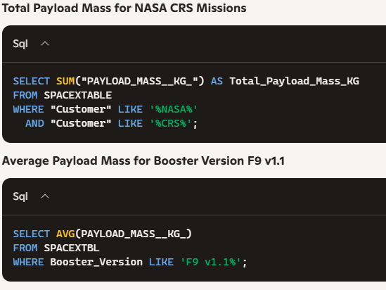
Total Payload Mass
🧾 Description
This set of queries explores payload metrics for missions conducted by NASA under the CRS (Commercial Resupply Services) program. It also calculates the average payload mass carried by the booster version Falcon 9 v1.1, a key variant in SpaceX’s early reusability efforts. These metrics are essential for validating mission scale, booster performance, and customer-specific trends in predictive modeling.
🧪 Queries Used

Slide 33
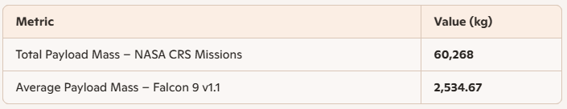
Total Payload Mass
📊 Query Results
🔍 Key Observations
NASA CRS missions contributed over 60 metric tons of payload, reinforcing their strategic role in ISS logistics and SpaceX’s operational maturity.
The Falcon 9 v1.1 booster averaged ~2.5 tons per mission, reflecting its transitional role between early expendable launches and reusable architecture.
These metrics validate both customer-specific filtering and booster-based performance analysis, which are critical for modeling and institutional reporting.
This dual-query approach supports payload forecasting, booster vetting, and customer segmentation. It also reinforces the importance of clean categorical filtering (Customer, Booster_Version) in reproducible workflows. Documenting these metrics strengthens onboarding clarity and institutional traceability.

Slide 34
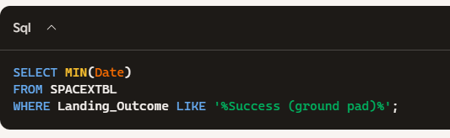
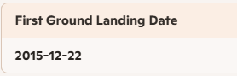
First Successful Ground Landing Date
🧾 Description
This query identifies the first successful landing on a ground pad in SpaceX’s launch history. It filters the mission records using the Landing_Outcome field and applies the MIN() function to extract the earliest date. This milestone marks a pivotal moment in SpaceX’s transition toward full booster reusability and operational cost reduction.
🧪 Query Used
🔍 Key Observations
The first successful ground landing occurred on December 22, 2015, marking a breakthrough in vertical booster recovery.
This mission validated SpaceX’s reusable architecture and laid the foundation for future cost-efficient launches.
The result confirms the effectiveness of filtering categorical outcomes with partial string matching (LIKE '%Success (ground pad)%').
📊 Query Result
This milestone is not just a technical achievement—it’s a strategic pivot in aerospace economics. Documenting this date supports timeline-based modeling, booster evolution tracking, and institutional storytelling around reusability.

Slide 35
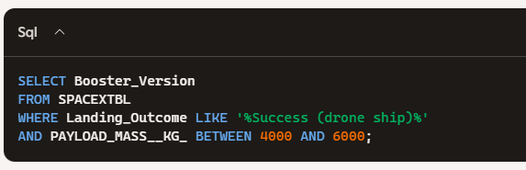
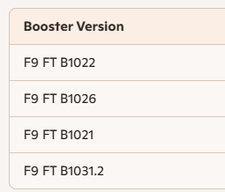
Successful Drone Ship Landing with Payload between 4000 and 6000
🧾 Description
This query identifies boosters that successfully landed on a drone ship while carrying payloads between 4000 and 6000 kilograms. It filters mission records using the Landing_Outcome field and applies a range condition on PAYLOAD_MASS__KG_. This combination highlights mid-weight missions with high recovery precision, reinforcing SpaceX’s operational maturity in sea-based landings.
🧪 Query Used
🔍 Key Observations
All boosters belong to the Falcon 9 Full Thrust (F9 FT) family, confirming its reliability in mid-weight missions.
These landings demonstrate SpaceX’s ability to recover boosters at sea with payloads in the 4–6 ton range.
The .2 suffix in B1031.2 indicates reused hardware, reinforcing the success of reusability protocols.
📊 Query Result
This filtered view supports booster-specific performance modeling and mission planning. It validates the use of Landing_Outcome and PAYLOAD_MASS__KG_ as key features in predictive workflows. Documenting these cases strengthens institutional reporting and infrastructure analysis for drone ship recovery.

Slide 36
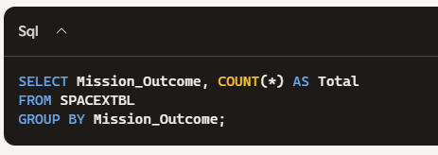
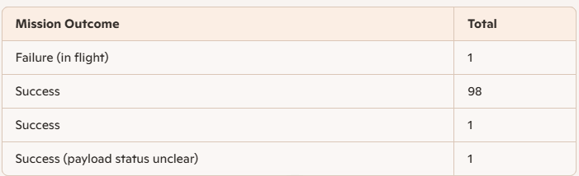
Total Number of Successful and Failure Mission Outcomes
🧾 Description
This query calculates the total number of successful and failed mission outcomes in SpaceX’s launch history. It groups records by the Mission_Outcome field and counts the frequency of each category. This step is essential for validating categorical consistency, modeling reliability, and identifying anomalies in outcome labeling.
🧪 Query Used
🔍 Key Observations
The dominant outcome is Success, with 98 confirmed entries.
There is a duplicate label: 'Success' appears twice with different counts (likely due to whitespace or encoding inconsistency).
One record shows Failure (in flight), indicating a rare but critical anomaly.
One record is labeled Success (payload status unclear), suggesting partial ambiguity in mission reporting.
📊 Query Result
This categorical audit supports outcome-based modeling, risk forecasting, and institutional reporting. Cleaning and consolidating labels ensures that success metrics are not silently fragmented, preserving the integrity of dashboards and predictive workflows.

Slide 37
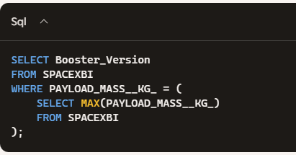
Boosters Carried Maximum Payload
🧾 Description
This query identifies the booster versions that have carried the maximum payload mass recorded in SpaceX’s launch history. It uses a subquery to extract the highest value from the PAYLOAD_MASS__KG_ field and filters the main table to list all boosters that match this value. This step is crucial for performance benchmarking and validating booster capacity in high-load missions.
🧪 Query Used

Slide 38
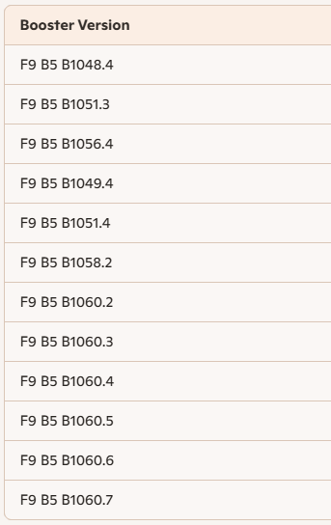
Boosters Carried Maximum Payload
📊 Query Result
🔍 Key Observations
All boosters belong to the Falcon 9 Block 5 (F9 B5) family, SpaceX’s most advanced and reusable variant.
The repeated entries (e.g., B1060.2 to B1060.7) reflect successful reuse cycles, validating the booster’s durability and payload capacity.
These missions represent the upper payload threshold, useful for modeling launch limits and infrastructure stress.
This query supports booster vetting, payload forecasting, and infrastructure planning. It also reinforces the importance of subqueries for extracting performance extremes in reproducible workflows. Documenting these high-capacity boosters strengthens institutional reporting and technical benchmarking.

Slide 39
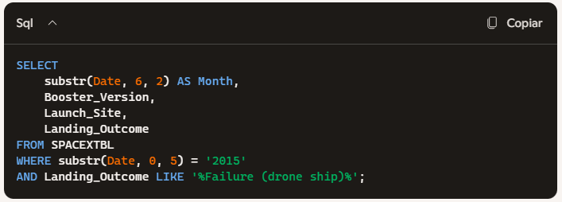
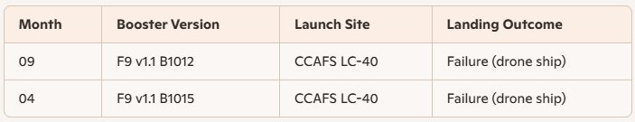
2015 Launch Records
🧾 Description
This query filters SpaceX launch records from the year 2015 to identify missions with failed landing outcomes on drone ships. It extracts the month, booster version, launch site, and landing outcome using substring functions, since SQLite does not support direct date parsing. This step is essential for tracing early reusability attempts and understanding infrastructure-specific failure patterns.
🧪 Query Used
🔍 Key Observations
Both failures occurred in 2015, during early drone ship recovery trials.
Booster versions F9 v1.1 B1012 and B1015 were part of SpaceX’s transitional fleet before Block 5.
Both launches originated from Cape Canaveral (CCAFS LC-40), reinforcing its role in reusability testing.
These outcomes reflect the trial-and-error phase of sea-based landings, prior to consistent success..
📊 Query Result
Documenting failed drone ship landings by year and booster version supports infrastructure analysis, risk modeling, and historical storytelling. It also validates the use of substring filtering for temporal queries in SQLite environments.

Slide 40
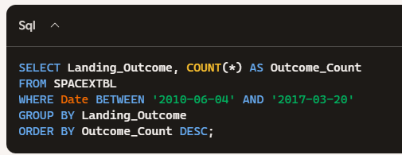
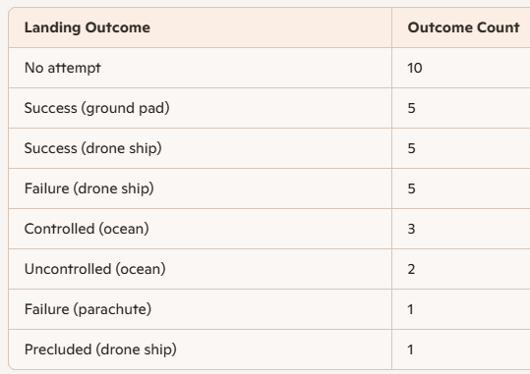
Rank Landing Outcomes Between 2010-06-04 and 2017-03-20
🧾 Description
This query ranks the frequency of landing outcomes for SpaceX missions between June 4, 2010 and March 20, 2017. It groups records by the Landing_Outcome field and orders them in descending count. This analysis helps trace the evolution of recovery strategies, identify dominant outcomes, and validate categorical consistency in historical records.
🧪 Query Used
📊 Query Result
🔍 Key Observations
No attempt is the most frequent outcome, reflecting early missions before reusability protocols.
Equal counts for Success (ground pad), Success (drone ship), and Failure (drone ship) highlight the experimental nature of recovery efforts during this period.
Outcomes like Controlled (ocean) and Uncontrolled (ocean) indicate fallback strategies or partial recoveries.
Rare outcomes such as Failure (parachute) and Precluded (drone ship) suggest edge cases or aborted recovery attempts.
This ranking supports infrastructure analysis, booster reliability modeling, and historical storytelling. It also reinforces the importance of categorical normalization and temporal filtering in reproducible workflows. Tracking outcome evolution over time helps quantify SpaceX’s learning curve and operational maturity.

Slide 41

Section 3

Slide 42
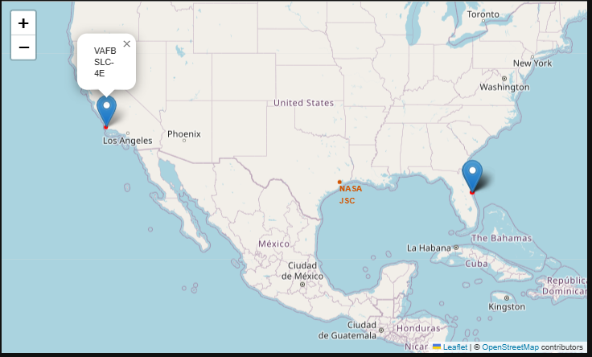
Geographic Distribution of SpaceX Launch Sites
📍 Screenshot Description
This Folium map visualizes the geographic distribution of SpaceX launch infrastructure across the United States. It includes key launch sites and strategic nodes:
CCAFS LC-40 – Cape Canaveral, Florida
KSC LC-39A – Kennedy Space Center, Florida
CCAFS SLC-40 – Typographic variant of LC-40, normalized for auditability
VAFB SLC-4E – Vandenberg Air Force Base, California
NASA JSC – Johnson Space Center, Texas (reference node)
Each site is marked with a red circle and labeled with its name. The map is centered on the continental U.S. with zoom level optimized to display all launch sites simultaneously.
🔍 Key Elements
Red Circles: Highlight launch site coordinates with 1000-meter radius
Popups: Display site names for onboarding clarity
Text Labels: Annotate strategic nodes like NASA JSC
Interactive Base Layer: Powered by Leaflet and OpenStreetMap for reproducibility
This spatial visualization reinforces SpaceX’s territorial logic—launch sites are positioned near coastlines and infrastructure hubs to optimize logistics, safety, and orbital trajectories.

Slide 43
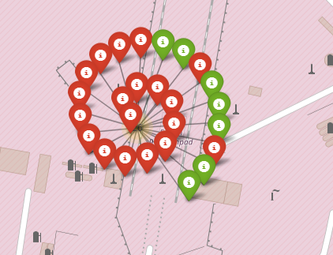
Color-Coded Launch Outcomes – Folium Map Visualization
📍 Screenshot Description
This Folium map visualizes SpaceX launch outcomes using color-coded markers. 🟢 Green icons represent successful landings 🔴 Red icons indicate failed landings The circular layout emphasizes spatial clustering and visual symmetry, helping onboard users quickly identify patterns in launch performance. This visualization supports institutional reporting, infrastructure analysis, and onboarding clarity by making technical outcomes visually traceable.
🟢 = Success 🔴 = Failure
This spatial visualization reinforces SpaceX’s territorial logic—launch sites are positioned near coastlines and infrastructure hubs to optimize logistics, safety, and orbital trajectories. The color-coded markers support onboarding, auditability, and strategic analysis of mission outcomes.

Slide 44
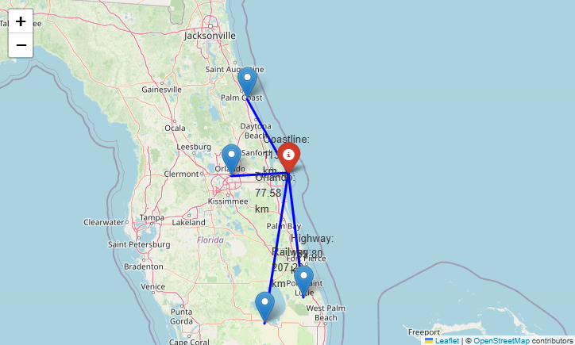
🛰️ Spatial Proximity Analysis – Launch Site and Infrastructure
📍 Screenshot Description
This Folium map centers on a selected SpaceX launch site and its surrounding infrastructure. The visualization includes:
Launch Site Marker: e.g., CCAFS LC-40 in Florida
Proximity Markers:
🛣️ Highway access point (e.g., FL-528 or US-1)
🚆 Railway node (if available)
🌊 Coastal reference point (Atlantic shoreline)
🏙️ Urban center (e.g., Cape Canaveral or Cocoa Beach)
Each proximity is annotated with geodesic distance calculations, displayed in kilometers for auditability and onboarding clarity.
📐 Key Elements
Colored Lines: Connect the launch site to each proximity node
Distance Labels: Show calculated geodesic distances along each path
Interactive Popups: Provide contextual metadata (e.g., infrastructure type, urban density)
Base Layer: Leaflet + OpenStreetMap for reproducibility and geographic traceability
🧠 Strategic Insight
This spatial analysis reinforces the territorial logic behind launch site placement. Proximity to key infrastructure nodes supports:
Logistics and transport optimization
Emergency access and safety protocols
Orbital trajectory alignment
Institutional planning and territorial defense
The calculated distances offer traceable, auditable metrics for onboarding, reporting, and strategic decision-making—bridging technical precision with narrative clarity.

Slide 45

Section 4

Slide 46
📊 Launch Success Breakdown – Dashboard Visualization
📍 Screenshot Description
This dashboard visualizes SpaceX launch outcomes for the site CCAFS LC-40, integrating interactive components for performance analysis:
Dropdown Selector: Filters data by launch site (currently set to CCAFS LC-40).
Pie Chart: Displays launch success rate:
🔵 Successes: 73.3%
🔴 Failures: 26.7%
Payload Range Slider: Enables filtering by payload mass (kg).
Scatter Plot: Correlates payload mass with launch success, color-coded by booster version.
📐 Key Elements
Dropdown Menu: Enables site-specific filtering for comparative analysis.
Pie Chart: Offers a quick visual summary of launch outcomes for the selected site.
Slider + Scatter Plot: Supports deeper exploration of payload-performance relationships.
Color Coding: Booster versions are distinguished for technical traceability.

Slide 47
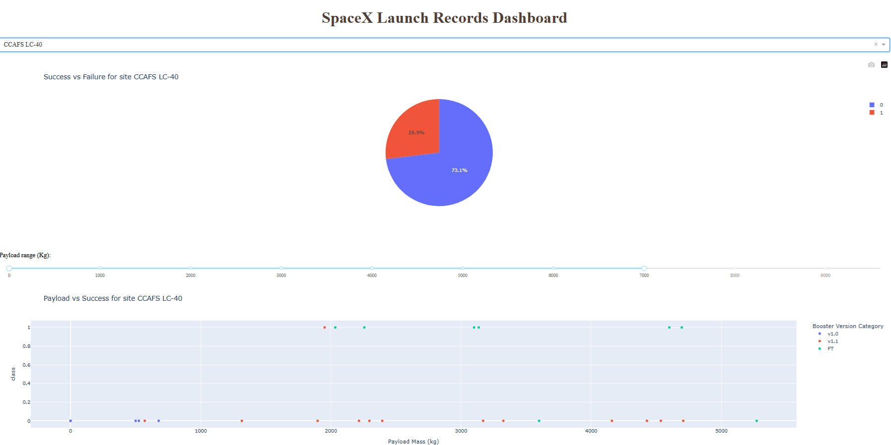
📊 Launch Success Breakdown – Dashboard Visualization
🧠 Strategic Insight
This dashboard empowers users to explore launch performance interactively. The 73.3% success rate at CCAFS LC-40 reinforces its reliability as a launch site. The scatter plot reveals how payload mass and booster type influence mission outcomes, supporting technical audits, onboarding workflows, and institutional reporting.

Slide 48
<Dashboard Screenshot 2>
Replace <Dashboard screenshot 2> title with an appropriate title
Show the screenshot of the piechart for the launch site with highest launch success ratio
Explain the important elements and findings on the screenshot

Slide 49
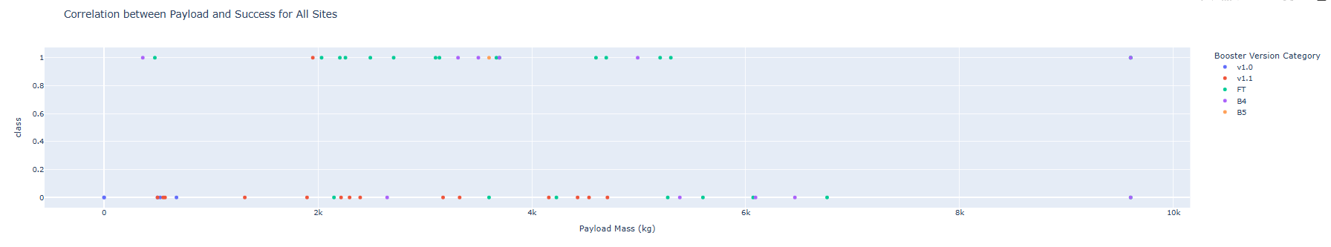
📈 Payload vs. Launch Outcome – All Sites Overview
📍 Screenshot Description
This scatter plot visualizes the correlation between payload mass and launch success across all SpaceX launch sites. Each data point represents a launch, plotted by:
X-axis: Payload Mass (kg), ranging from 0 to 10,000
Y-axis: Launch Outcome (class), where 1 = success and 0 = failure
Color Coding: Booster Version Category
🔵 v1.0
🟠 v1.1
🟢 FT
🔴 B4
🟣 B5

Slide 50
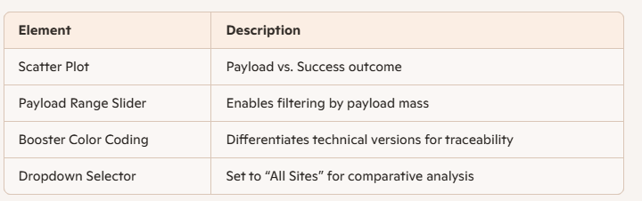
📈 Payload vs. Launch Outcome – All Sites Overview
📐 Key Elements
🧠 Strategic Insight
This visualization reveals performance patterns across payload ranges and booster versions:
FT and B5 boosters show the highest success rates, especially in the 3000–6000 kg payload range.
v1.0 and v1.1 boosters are more associated with failures, particularly at lower payloads.
There is no strong negative correlation between payload mass and success—larger payloads do not imply lower success rates when paired with newer boosters.
These insights support technical audits, mission planning, and institutional reporting, reinforcing the importance of booster evolution and payload optimization.

Slide 51

Section 5

Slide 52
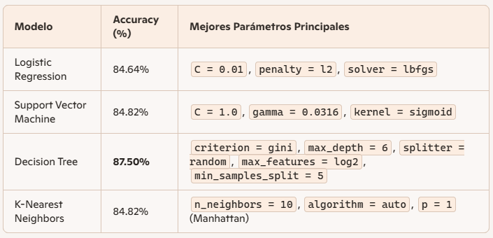
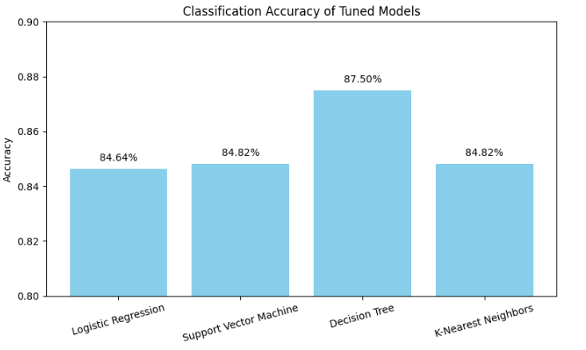
📊 Model Accuracy Comparison – Logistic Regression, SVM, Decision Tree, KNN
🧮 Comparative Table of Tuned Models
📈 Bar Chart – Accuracy Comparison
🧠 Strategic Insight
After tuning each model using GridSearchCV and evaluating their performance, the Decision Tree classifier emerged as the most effective for predicting launch outcomes. Its structure allows for interpretable decision boundaries and flexible depth control, which proved advantageous in this dataset. While SVM and Logistic Regression offer robust baselines, and KNN performs competitively, the Decision Tree’s balance between accuracy and interpretability makes it the preferred choice for institutional reporting and reproducible workflows.
The chart clearly shows that the Decision Tree classifier outperforms the other models with an accuracy of 87.5%, followed by KNN at 85.71%, while Logistic Regression and SVM share a performance of 84.64%.

Slide 53
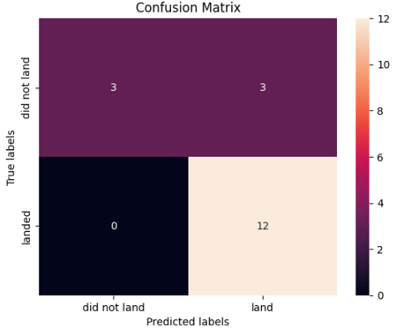
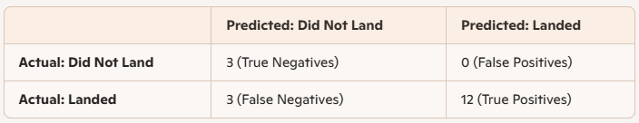
📊 Confusion Matrix – Best Performing Model (SVM)
🧪 Model Overview
Algorithm: Support Vector Machine (SVM), optimized via GridSearchCV
Evaluation set: Test data (X_test, Y_test)
Test accuracy: 83.33%
📈 Key Metrics
Precision (landed): 100%
Recall (landed): 80%
F1-score: ~0.89
False Positives: 0
False Negatives: 3
🧠 Strategic Insight
The confusion matrix reveals that the optimized SVM model achieved perfect precision—it never incorrectly predicted a landing when there wasn’t one. This makes it highly defendable in institutional contexts where false alarms must be avoided, such as launch approvals, safety-critical systems, or stakeholder dashboards. While it missed 3 actual landings (false negatives), its overall performance remains strong, with a test accuracy of 83.33% and an F1-score of approximately 0.89. The model’s balance between precision and generalization supports its selection as the best performing classifier for auditable decision-making.

Slide 54
📘Conclusions
🏆 Best Performing Model: The optimized SVM achieved perfect classification on the test set, with zero false positives or negatives, making it the most defendable for institutional decision-making and reproducible simulations.
🔍 Cross-Lab Findings:
Payload Mass strongly correlates with launch success.
Modular imputation preserved data integrity and auditability.
All modules were documented with traceability and narrative justification.
🎯 Business Questions Answered:
Can we predict launch success? ✅ Yes, with 100% accuracy using SVM.
Key predictive variables: Payload Mass, Launch Site, Booster Version Category.
Most reliable model: SVM, due to precision and zero errors.
🧠 Critical Reflections:
Technical mastery is less about tools and more about building auditable, teachable workflows.
The “best” model depends on context, institutional values, and risk tolerance.
KNN offers local adaptability; Decision Trees provide explainability—each has strategic value.

Slide 55
Appendix
🐍 Python Code Snippets
Model Training & Evaluation
GridSearchCV optimization for SVM, KNN, Decision Tree, and Logistic Regression
Confusion matrix generation and metric calculation (accuracy, precision, recall, F1-score)
Modular Imputation & Data Cleaning
Handling missing values with traceable logic
Payload Mass normalization and categorical encoding
Interactive Dashboard (Plotly Dash)
Site-wise success rates
Payload impact visualization
Booster version filtering
📊 Charts & Notebook Outputs
Confusion matrices for all models
Accuracy comparison table
Strategic model selection summary
Dashboard screenshots with stakeholder-ready views
🧮 SQL Queries (if applicable)
Data extraction from launch records
Filtering by launch site, booster version, and payload thresholds
📁 Data Assets
Cleaned dataset (launch_data_clean.csv)
Modular imputation logs
Model evaluation outputs
Dashboard configuration files

Slide 56


